Slide 1

R_{x}
Consultation

Slide 2
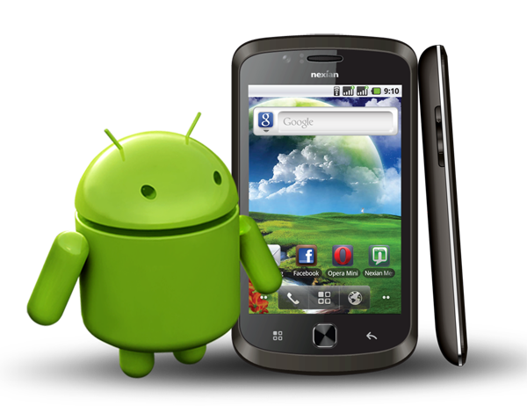





Project Abstract
R_{x} Consultation is an application that can be used to create an e –prescription and facilitates online-doctor consultation. The primary motive of this project is to develop an application to help a patient take medicines as prescribed (as per dosage) without fail and to maintain a systematic communication between doctor and patient. R_{x} Consultation is a Web-app (for doctors) and an android application (for patient).
.

Slide 3

Project Abstract - Webapp
R_{x} Consultation (Web-app) will be developed for doctors to create prescriptions which will be stored in the azure database. This prescription will contain the personal details of the patient, case history and medical history of the patient, issue date of the prescription, validity of the prescription and prescribed medicines with dosage details. Initially doctor has to input login credentials to use the applications. A doctor can view previous prescriptions he issued as well as create new prescription. This can be a way to recording information about all the patient a doctor attended in a given period of time.

Slide 4
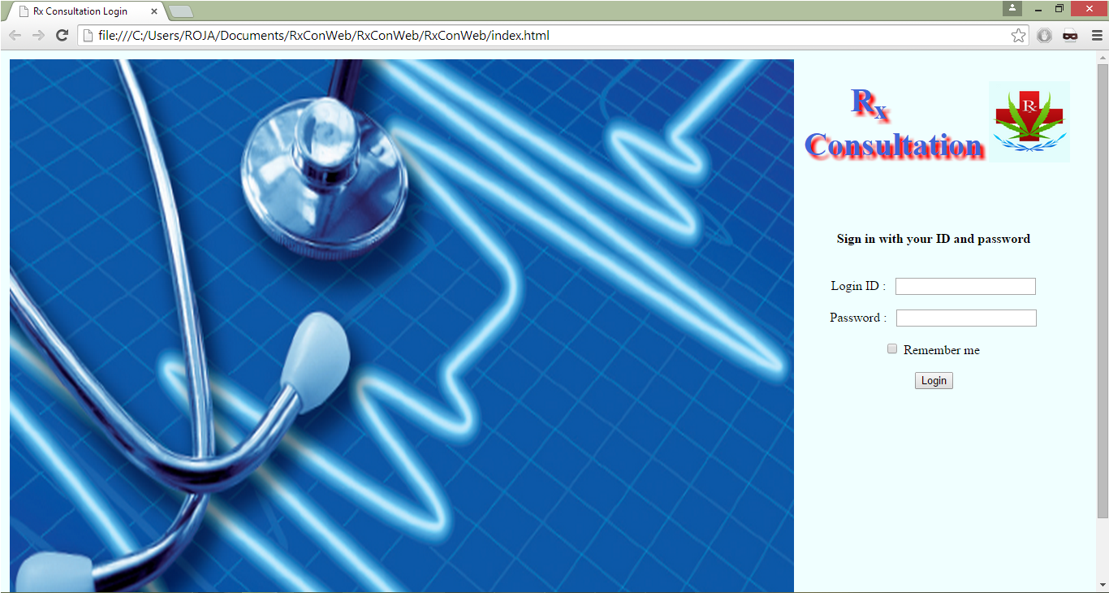
Screen Shots- Webapp
Doctor enters login id and password (already registered in database)
And click Login

Slide 5
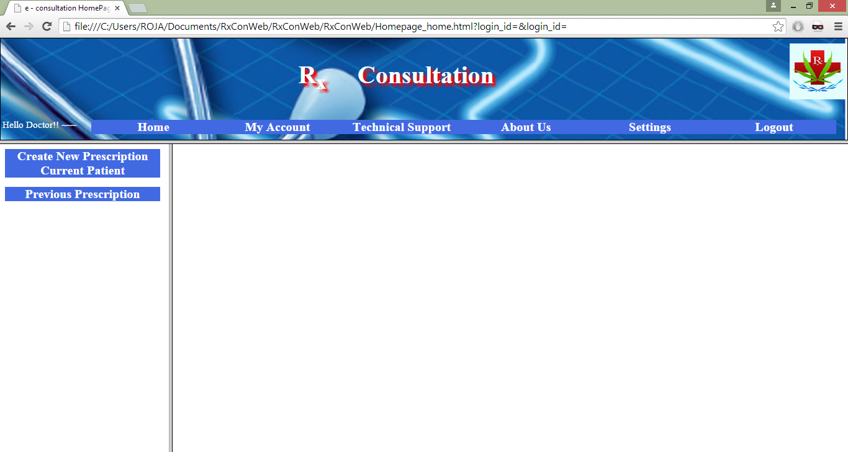
Screen Shots- Webapp
R_{x} Consultation -
Home Page
Home- Redirect to home page
My Account – to edit or view Doctor’s details
Technical Support – If doctor needs technical assistance
About Us – Details about project
Settings – Page Settings
Logout – Sends the session

Slide 6
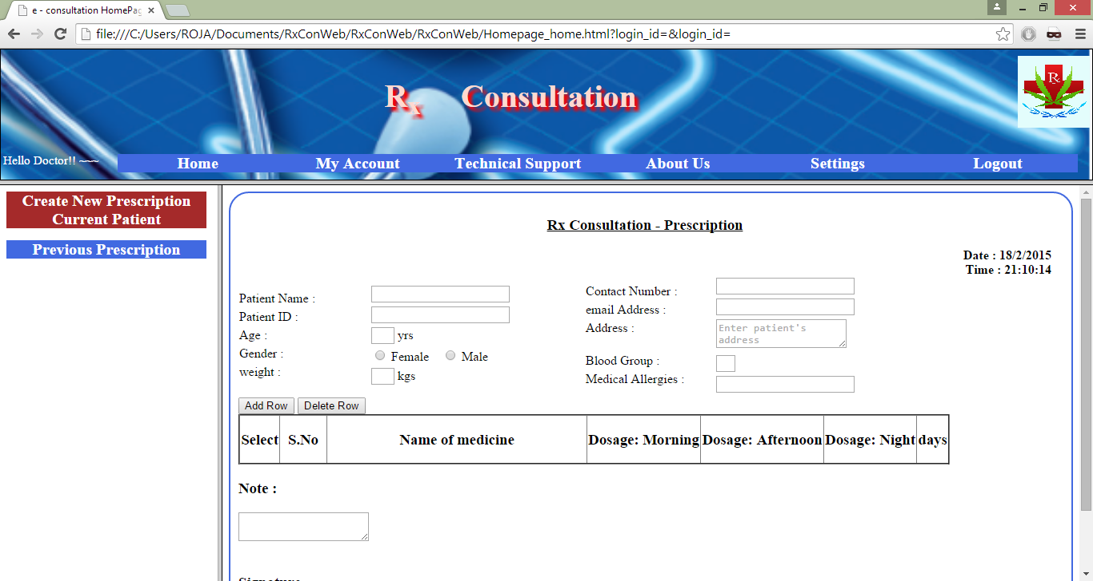
Screen Shots- Webapp
Create new prescription
or View
Previous prescriptions

Slide 7
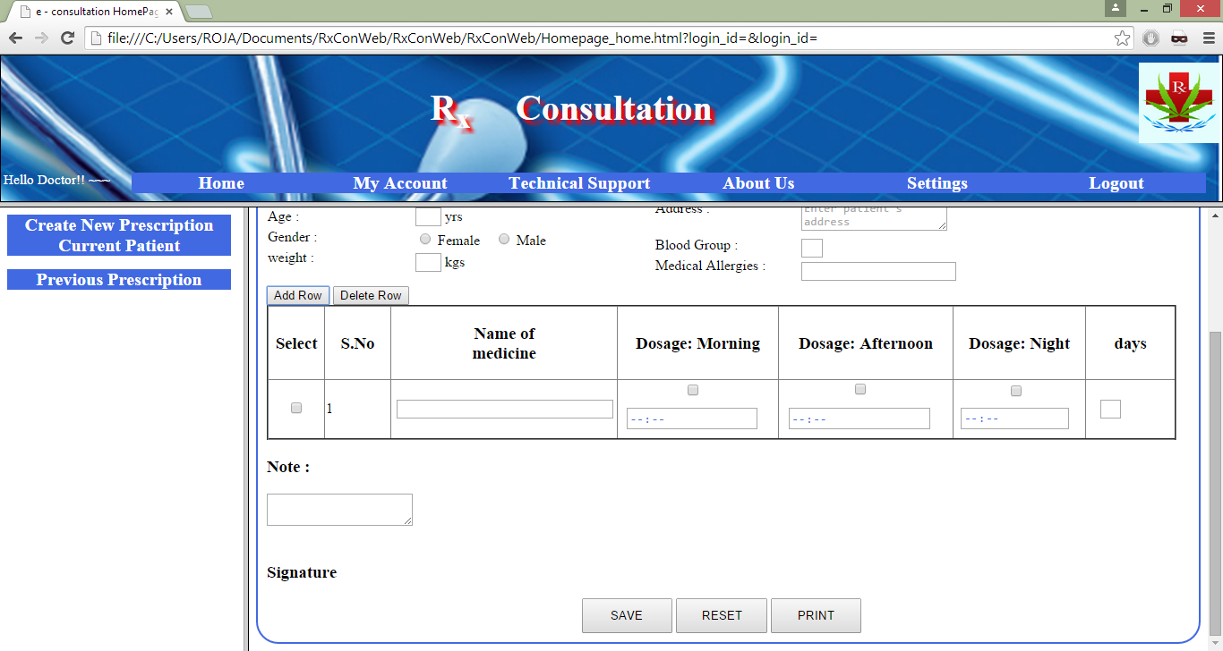
Screen Shots- Webapp
Add rows or delete rows
Save – saves the prescription to the database
Reset – resets the form
Print – Print the prescription

Slide 8
Project Abstract - Mobile App
R_{x} Consultation (Mobile app) will be available for patients. This app will give alerts to the patient about the medicines to be taken at regular intervals of time and it will have other features like emergency message and call, consultation chat with the doctor etc. A patient can login to check the prescription, start and stop alerts based on the requirement. Consultation chat feature can be used by the patient in case of any issues or concerns regarding the prescriptions. Two contact details can be marked in the application, which will be use in case of emergency. This app will have doctor details for future reference. A constraint on prescription validity can be implemented. That is, the prescription will expire after its validity period.

Slide 9
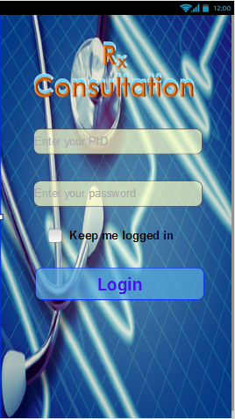
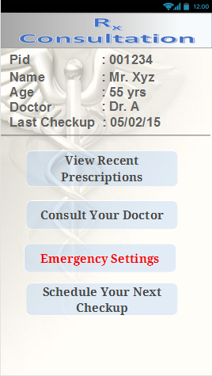
Screen Shots- Mobile App
Login Screen
Enter PID and Password to login
Welcome Screen
Patient Details
View recent prescription
Consult your Doctor
Emergency Settings
Schedule your next Check-up

Slide 10
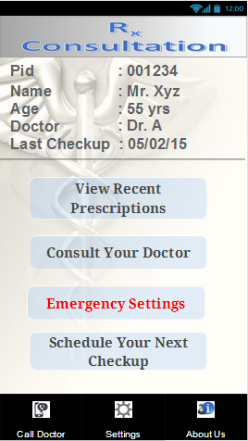
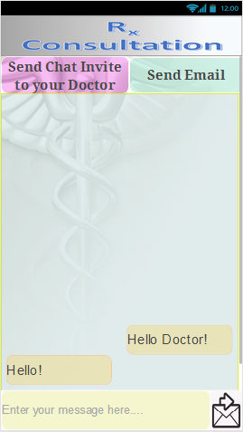
Screen Shots- Mobile App
- App menu
Call Doctor
Settings
About Us
- Consult your doctor
Send Chat Invite to your doctor
Send Email
Chat screen

Slide 11
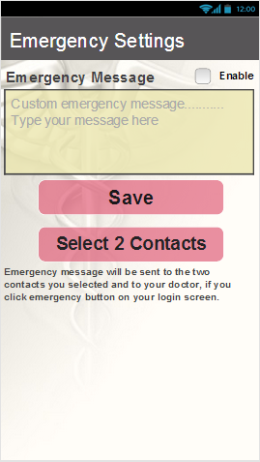
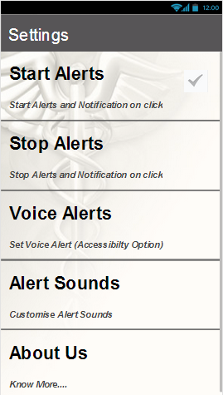
Screen Shots- Mobile App
- Emergency Settings
Save Custom message
Select 2 Contacts
- Settings
Start Alert
Stop Alert
Voice Alert
Alert Sounds
About Us

Slide 12

Questions ?

Slide 13
Thank You …
Roja Raman

